Slide 1
Enabling Cross-Origin Requests in ASP.NET Web API Core
Enabling CORS

Slide 2
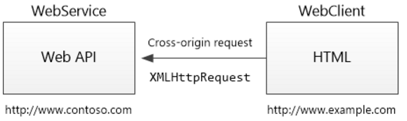
Cross-Origin-Resource-Sharing (CORS)
Browser security prevents a web page from making AJAX requests to another domain. This restriction is called the same-origin policy, and prevents a malicious site from reading sensitive data from another site. However, sometimes you might want to let other sites call your web API.
CORS is a W3C standard that allows a server to relax the same-origin policy.
Using CORS, a server can explicitly allow some cross-origin requests while rejecting others.
CORS is safer and more flexible than earlier techniques such as JSONP.

Slide 3
CORS - Demo
Create Simple Web API Service Project
Example http://apiservice:9090/api/test
Create Simple MVC Client Project
Example http://apiclient:8080/home/index
Let MVC Client make a AJAX request to API service

Slide 4
Enable CORS in ASP.Net Core Web API
There are three ways to enable CORS:
In middleware using a named policy or default policy.
Using endpoint routing.
***With the [EnableCors] attribute.
Using the [EnableCors] attribute with a named policy provides the finest control in limiting endpoints that support CORS.
Notes:
https://docs.microsoft.com/en-us/aspnet/core/security/cors?view=aspnetcore-6.0

Slide 5
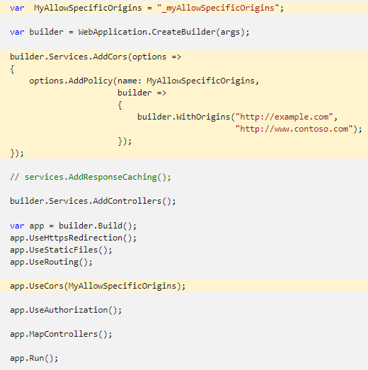
CORS with named policy and middleware
Notes:
var MyAllowSpecificOrigins = "_myAllowSpecificOrigins";
var builder = WebApplication.CreateBuilder(args);
builder.Services.AddCors(options =>
{
options.AddPolicy(name: MyAllowSpecificOrigins,
builder =>
{
builder.WithOrigins("http://example.com",
"http://www.contoso.com");
});
});
// services.AddResponseCaching();
builder.Services.AddControllers();
var app = builder.Build();
app.UseHttpsRedirection();
app.UseStaticFiles();
app.UseRouting();
app.UseCors(MyAllowSpecificOrigins);
app.UseAuthorization();
app.MapControllers();
app.Run();

Slide 6
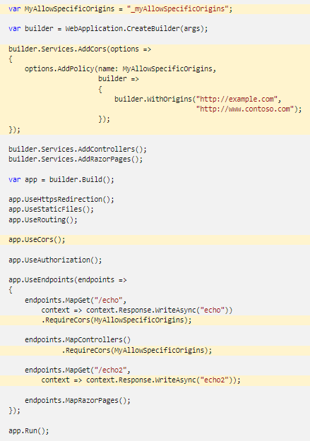
Enable CORS with endpoint routing
Notes:
var MyAllowSpecificOrigins = "_myAllowSpecificOrigins";
var builder = WebApplication.CreateBuilder(args);
builder.Services.AddCors(options =>
{
options.AddPolicy(name: MyAllowSpecificOrigins,
builder =>
{
builder.WithOrigins("http://example.com",
"http://www.contoso.com");
});
});
builder.Services.AddControllers();
builder.Services.AddRazorPages();
var app = builder.Build();
app.UseHttpsRedirection();
app.UseStaticFiles();
app.UseRouting();
app.UseCors();
app.UseAuthorization();
app.UseEndpoints(endpoints =>
{
endpoints.MapGet("/echo",
context => context.Response.WriteAsync("echo"))
.RequireCors(MyAllowSpecificOrigins);
endpoints.MapControllers()
.RequireCors(MyAllowSpecificOrigins);
endpoints.MapGet("/echo2",
context => context.Response.WriteAsync("echo2"));
endpoints.MapRazorPages();
});
app.Run();

Slide 7
Enable CORS with attributes
The [EnableCors] attribute provides an alternative to applying CORS globally.
The [EnableCors] attribute enables CORS for selected endpoints, rather than all endpoints:
[EnableCors] specifies the default policy.
[EnableCors("{Policy String}")] specifies a named policy.

Slide 8
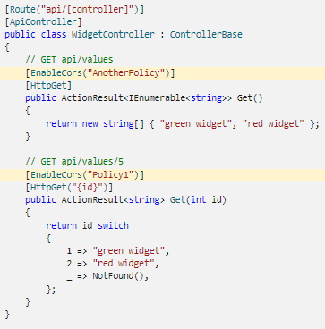
Enable CORS with attributes
Notes:
[Route("api/[controller]")]
[ApiController]
public class WidgetController : ControllerBase
{
// GET api/values
[EnableCors("AnotherPolicy")]
[HttpGet]
public ActionResult<IEnumerable<string>> Get()
{
return new string[] { "green widget", "red widget" };
}
// GET api/values/5
[EnableCors("Policy1")]
[HttpGet("{id}")]
public ActionResult<string> Get(int id)
{
return id switch
{
1 => "green widget",
2 => "red widget",
_ => NotFound(),
};
}
}
var builder = WebApplication.CreateBuilder(args);
builder.Services.AddCors(options =>
{
options.AddPolicy("Policy1",
builder =>
{
builder.WithOrigins("http://example.com",
"http://www.contoso.com");
});
options.AddPolicy("AnotherPolicy",
builder =>
{
builder.WithOrigins("http://www.contoso.com")
.AllowAnyHeader()
.AllowAnyMethod();
});
});
builder.Services.AddControllers();
var app = builder.Build();
app.UseHttpsRedirection();
app.UseRouting();
app.UseCors();
app.UseAuthorization();
app.MapControllers();
app.Run();

